Slide 1

Test Data
CGC_REBOUNDER

Slide 2
CASES
We are Using Two cases
Analog Signal That are Linked with the IBM Cloud
As Well as App Cases
We cant Save Our Cloud DATA Because we are using Bluetooth Connectivity not any Wifi module but we are able to sync our Analog Signal here it Follows Through IBM

Slide 3
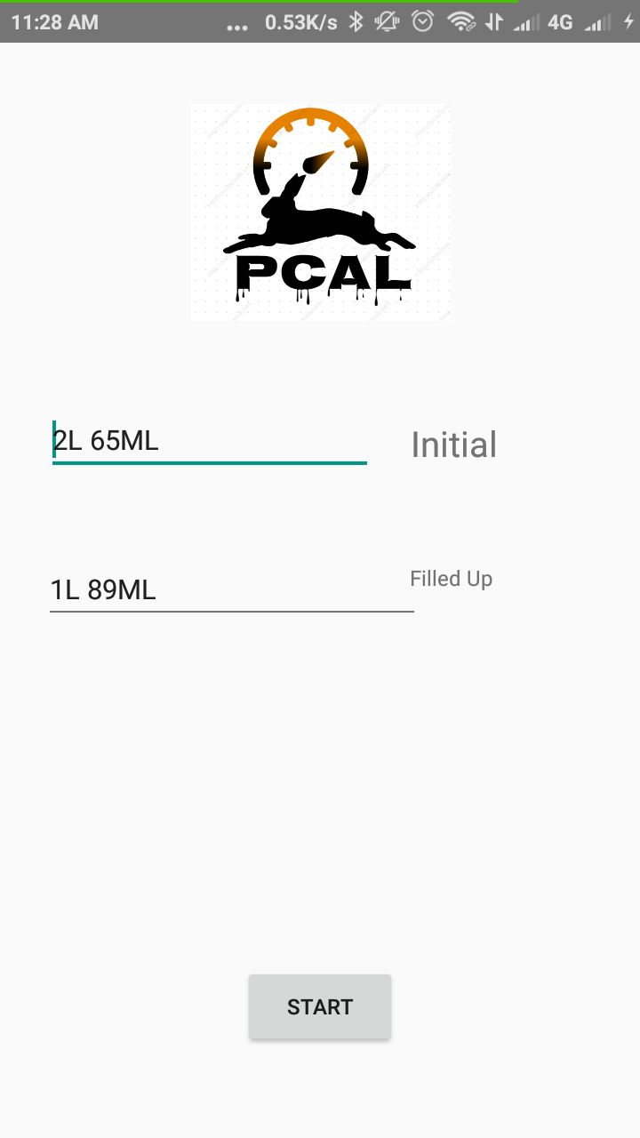
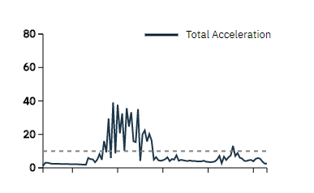
CASE !

Slide 4
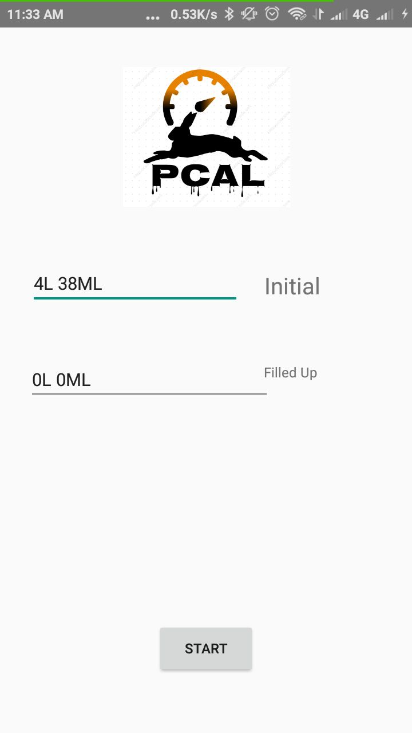
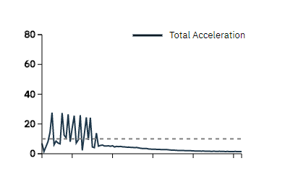
CASE !!
When the Turbine Stop Rotating the analog
Signal Tends to show the null value
And the App show increase In initial state
And Filled up will start again when ever user
Click on the start button and turbine start Rotating

